Slide 1
Marketing Segmentation

Slide 2
Outlines: models
View the data set
Hierarchical clustering:
Partition based methods: K-means, k-centroid
Model-based: Latent Gold and EM based
Bayesian based
Density based clustering: DBSCAN

Slide 3
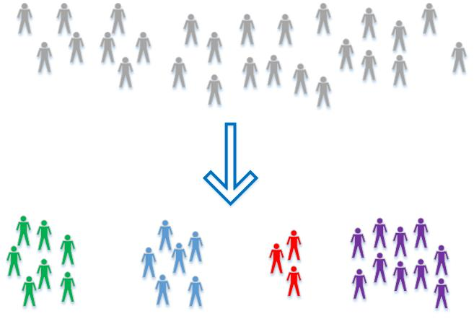
What is market segmentation
Market segmentation describes the division of a market into homogeneous groups which will respond differently to promotions, communications, advertising and other marketing mix variables.
Why use segmentation
Easier marketing
Find niches
Efficient

Slide 4
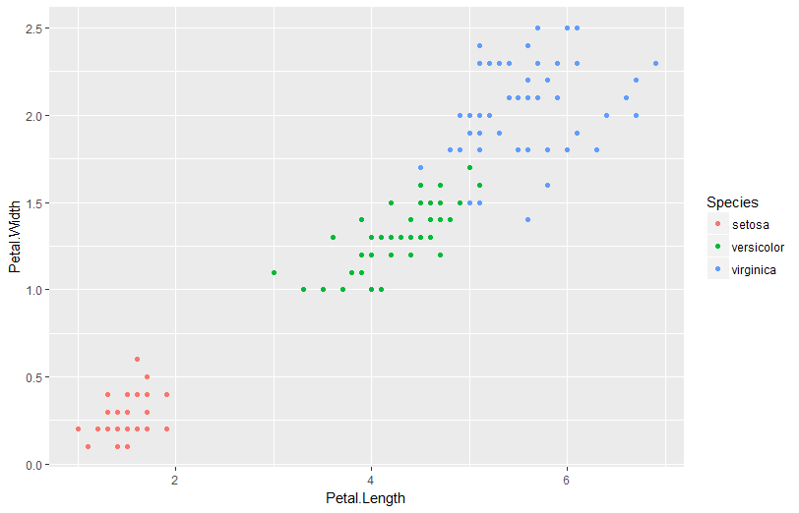
Iris Data
The iris dataset contains data about sepal length, sepal width, petal length, and petal width of flowers of different species.

Slide 5
Partition Clustering: K-means
K-means: Partition n observations into k clusters in which each observations belongs to the cluster with the nearest mean.
Algorithm: randomly assigns each observation to a cluster, and finds the centroid of each cluster. Then, the algorithm iterates through two steps:
Reassign data points to the cluster whose centroid is closest.
Calculate new centroid of each cluster.
Advantages: easy to implement
Disadvantages: can converge to local minima,; slow on very large datasets

Slide 6
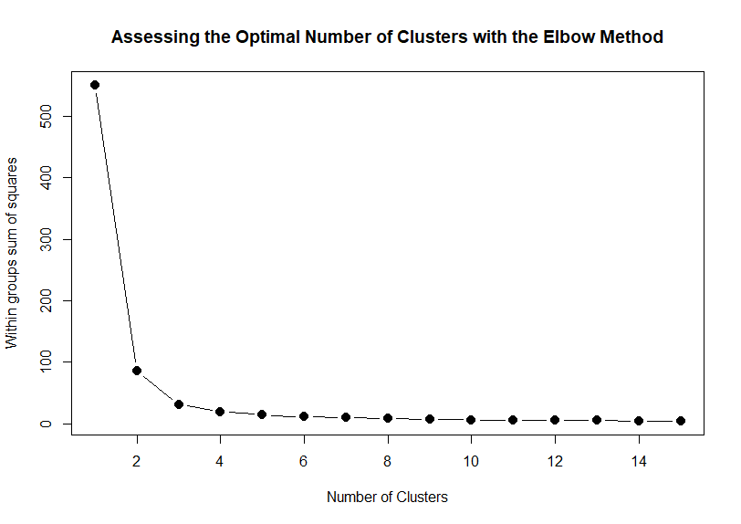
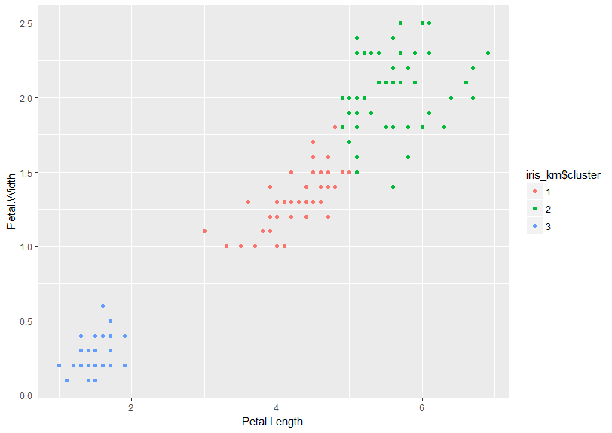
Clustering Example
Decide the Optimize clusters
Clustering with 2 clusters

Slide 7
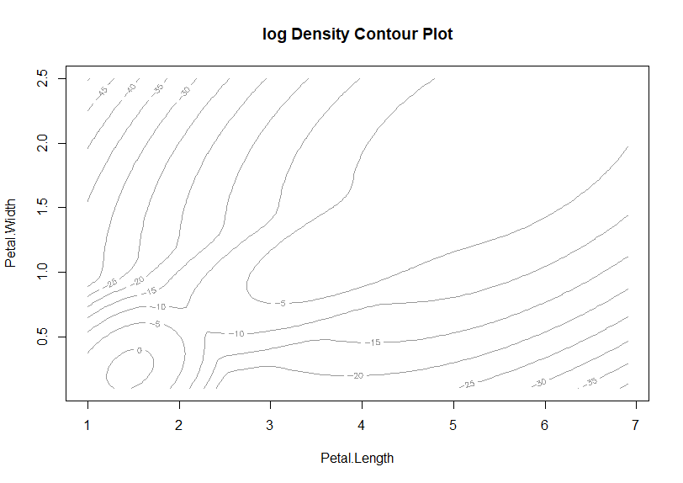
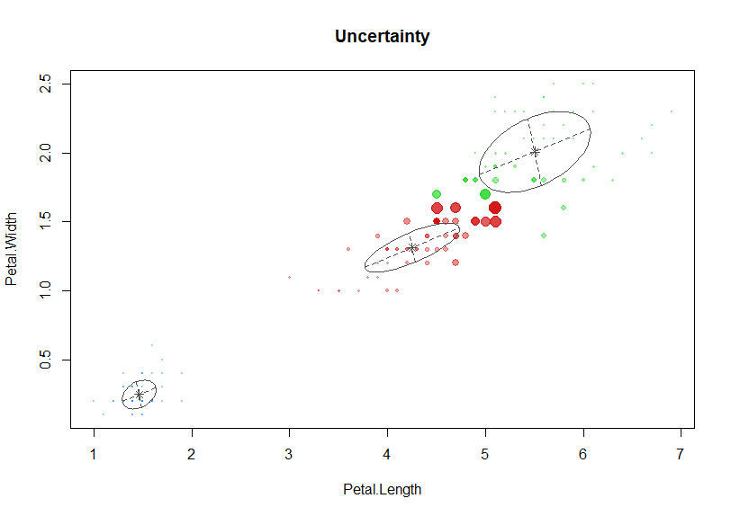
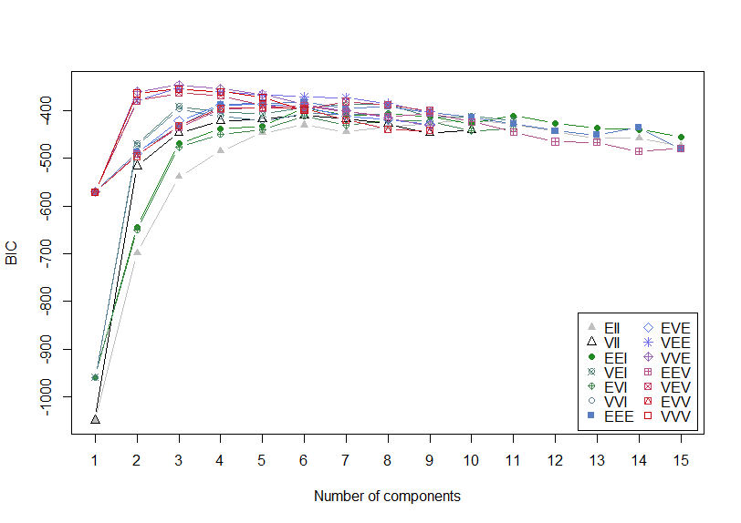
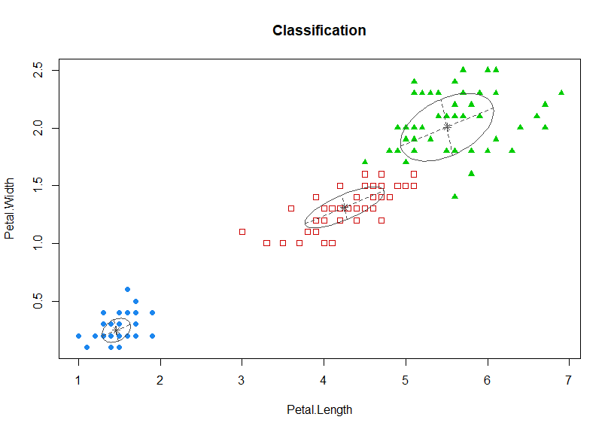
Bayesian Inference Criterion for K means

Slide 8
Hierarchical Clustering
Algorithm :
Put each data point in its own cluster.
Identify the closest two clusters and combine them into one cluster.
Repeat the above step till all the data points are in a single cluster.
Determine how close two clusters are:
Complete linkage clustering: Find the maximum possible distance between points belonging to two different clusters.
Single linkage clustering: Find the minimum possible distance between points belonging to two different clusters.
Mean linkage clustering: Find all possible pairwise distances for points belonging to two different clusters and then calculate the average.
Centroid linkage clustering: Find the centroid of each cluster and calculate the distance between centroids of two clusters.

Slide 9
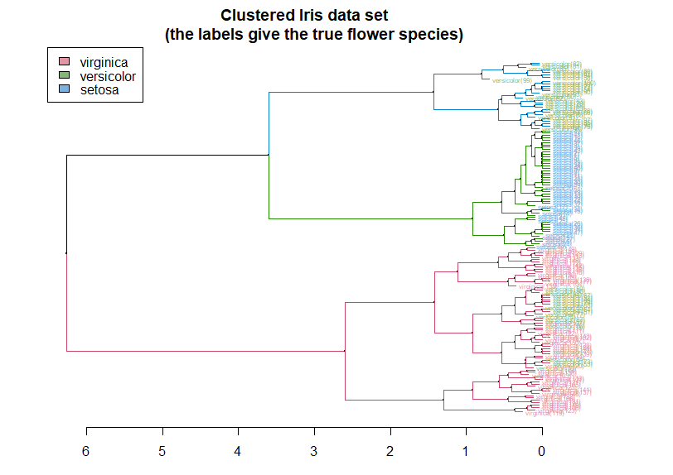
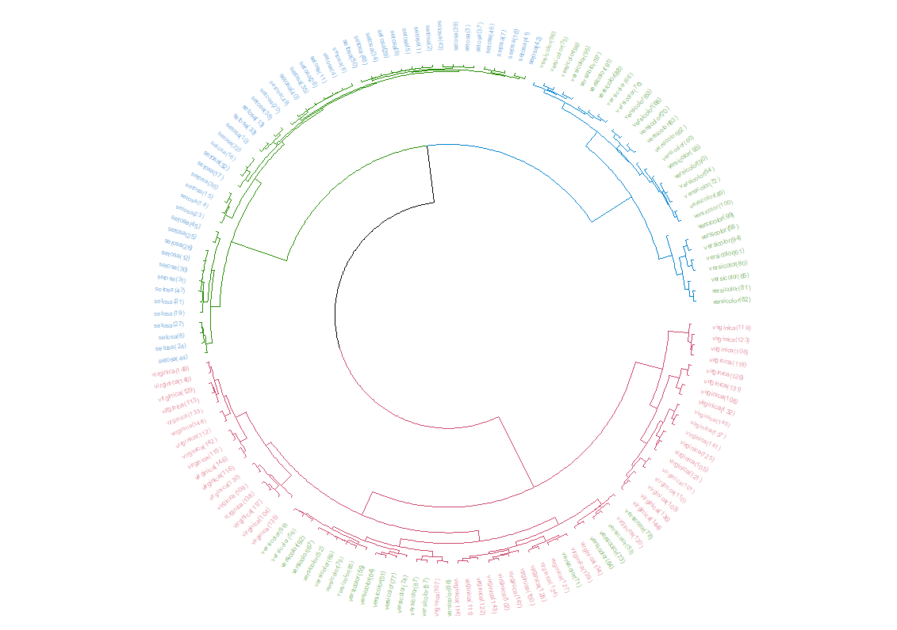
Hierarchical Clustering

Slide 10
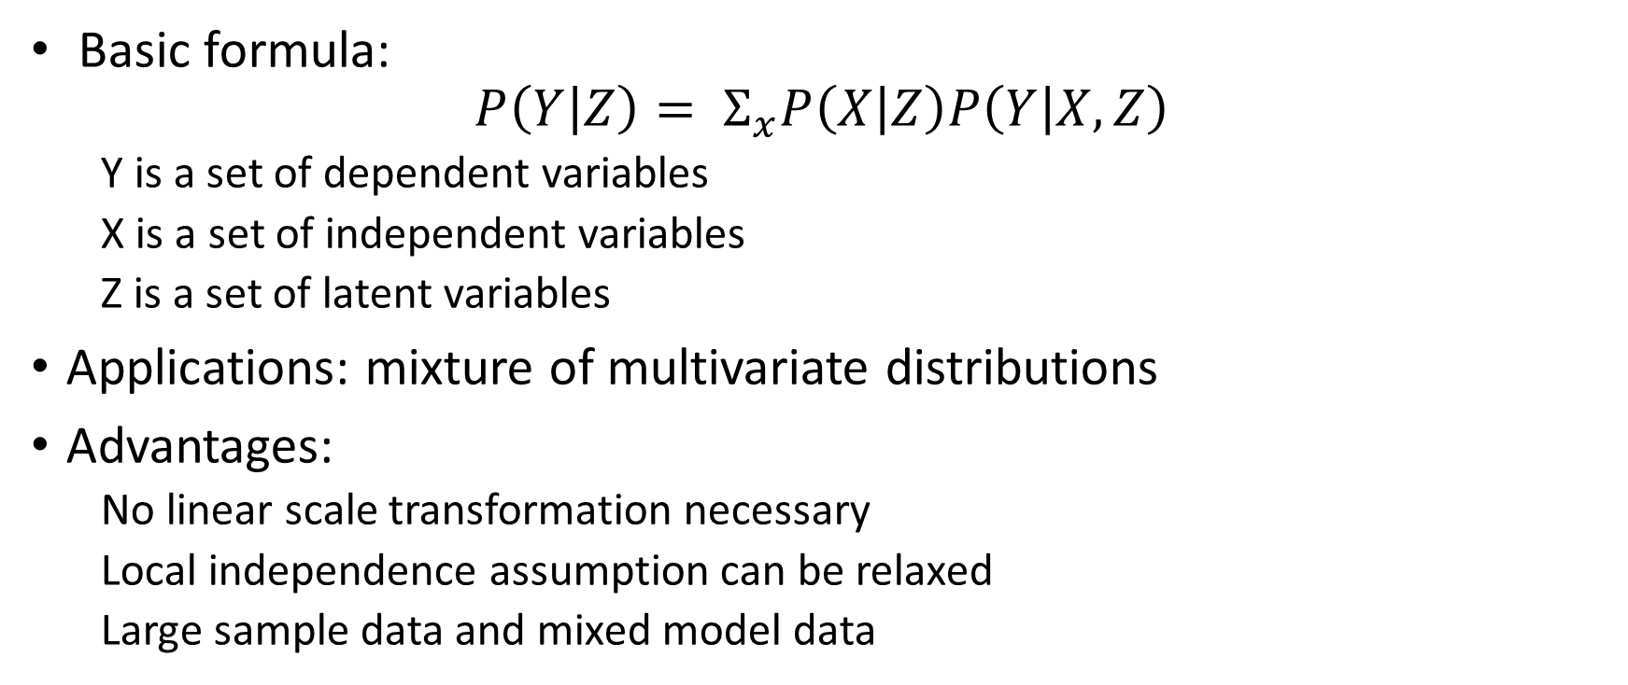
Model-based Clustering: Latent GOLD
Basic formula:
$$P\left(Y | Z\right)= Σ_{x}P\left(X | Z\right)P\left(Y | X, Z\right)$$
  Y is a set of dependent variables
  X is a set of independent variables
  Z is a set of latent variables
Applications: mixture of multivariate distributions
Advantages:
  No linear scale transformation necessary
  Local independence assumption can be relaxed
  Large sample data and mixed model data

Slide 11
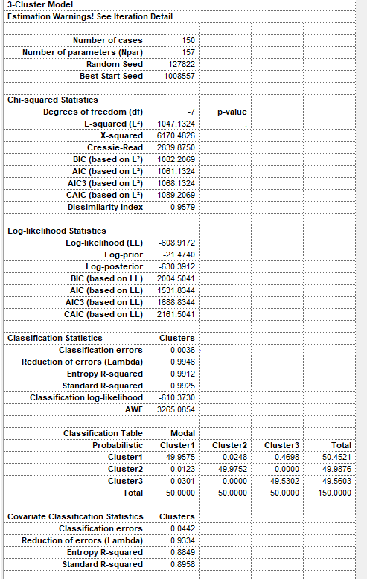
LatentGold
Number of clustered is determined by the statistics (AIC, BIC, LL)

Slide 12
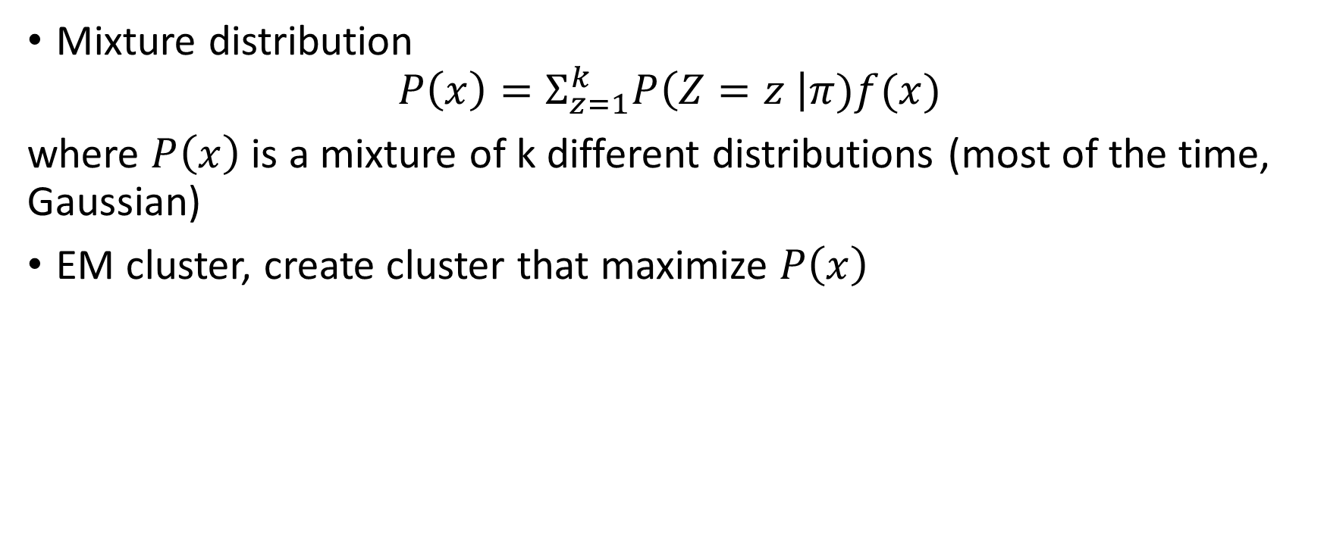
Model-based Clustering: EM cluster
Mixture distribution
$$P\left(x\right)=Σ_{z=1}^{k}P\left(Z=z \right|π)f(x)$$
where $P\left(x\right)$ is a mixture of k different distributions (most of the time, Gaussian)
EM cluster, create cluster that maximize $P\left(x\right)$

Slide 13
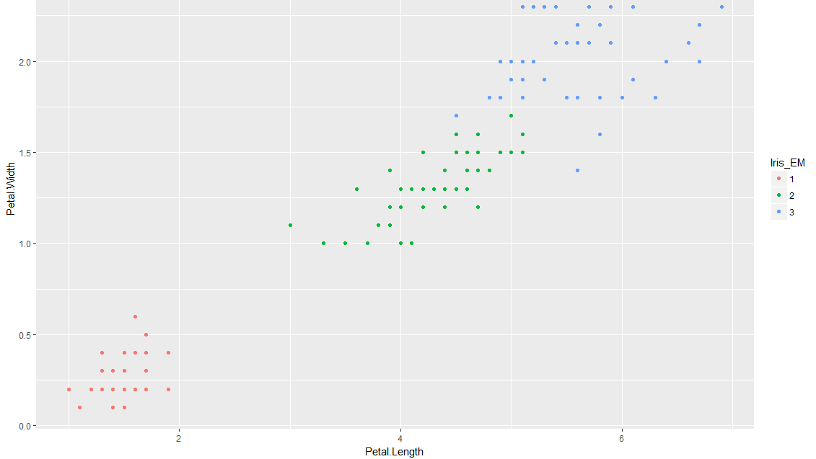
EM cluster
Pre-determine the number of clusters

Slide 14
Discussion of the model based cluster algorithms
Both two algorithms are based on mixture distributions. Algorithm will only converge when then the assumption are reasonable
The choice of the number of clusters are subjects to the data (might not converge for any given number of clusters)
LatentGOLD runs very slow when the number of variables are very large

Slide 15
Discussion of the model based cluster algorithms
Both two algorithms are based on mixture distributions. Algorithm will only converge when then the assumption are reasonable
The choice of the number of clusters are subjects to the data (might not converge for any given number of clusters)
LatentGOLD runs very slow when the number of variables are very large

Slide 16
Density Based: DBSCAN(density-based spatial clustering of applications with noise)
Define points as core points (with neighboring points fall with the radius) , border points (has fewer neighbors but lies within the radius of a core point) or noise points
Advantages:
  does not assume the clusters have a spherical shape
  Doesn’t necessarily assign each point to a cluster, could be noise points

Slide 17
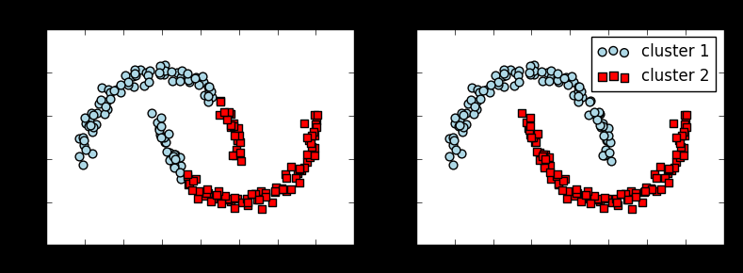
Example: compare K-means with DBSCAN, using a moon shape data
Kmeans
DBSCAN

Slide 18
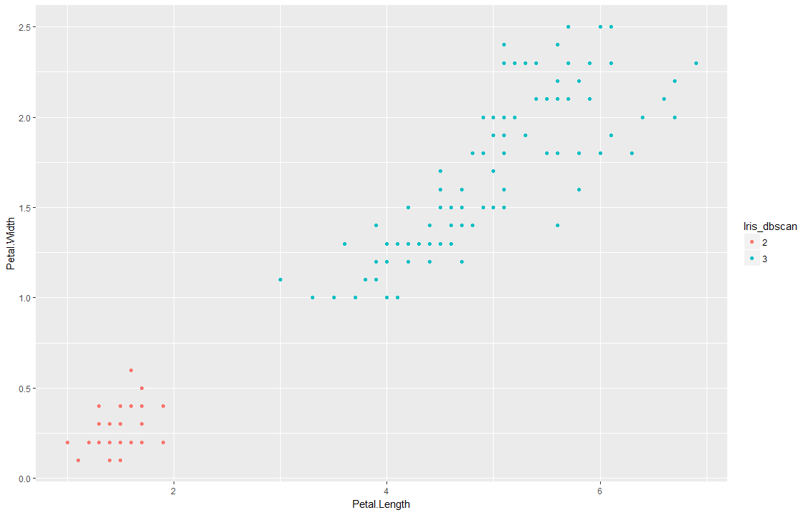
Density-Based Clustering
Calculate the K-nearest-neighborhood distance list
Decide the epsilon K-nearest-neighborhood from the knn-distance
Return number of clusters automatically depending on the epsilon

Slide 19
Cluster Evaluation
External validity measures
  Compare the cluster with the given labels of the segmentation
Internal validity measures & Relative validity measures
Predictive study base on the clustering data and labels

Slide 20
External- compare with existing labels
 | K-means |  |  | Hierarchical |  |  | LatentGold |  |  | EM |  |  | DBSCAN
setosa | 50 | 0 | 0 | 50 | 0 | 0 | 50 | 0 | 0 | 50 | 0 | 0 | 50 | 0
versicolor | 0 | 48 | 2 | 0 | 29 | 21 | 0 | 50 | 0 | 0 | 49 | 1 | 0 | 50
virginica | 0 | 4 | 46 | 0 | 0 | 50 | 0 | 0 | 50 | 0 | 2 | 48 | 0 | 50

Slide 21
Internal & Relative Measurement (across models)
Method | cluster | min.clust.size | avg.between | avg.within | avg.silwidth | Dunn's | entropy | CH | Sep.index
Kmeans | 3 | 48.00 | 3.00 | 0.52 | 0.66 | 0.05 | 1.10 | 1217.19 | 0.16
Hierarchical | 3 | 46.00 | 3.00 | 0.53 | 0.66 | 0.07 | 1.10 | 1194.03 | 0.22
LatentGold | 3 | 50.00 | 3.00 | 0.53 | 0.64 | 0.00 | 1.10 | 1139.56 | 0.09
EM | 3 | 49.00 | 3.00 | 0.53 | 0.64 | 0.04 | 1.10 | 1128.22 | 0.17
DBSCAN | 2 | 50.00 | 3.74 | 0.93 | 0.77 | 0.32 | 0.64 | 785.28 | 1.52
Notes:
min.clust.size: size of smallest cluster.
avg.between: average distance between clusters.
avg.within: average distance within clusters.
avg.silwidth: average silhouette width: close to 1 is good
Dunn ratio of the smallest distance between observations not in the same cluster to the largest intra-cluster distance. Maximize
Entropy: entropy of the distribution of cluster memberships
CH: average between- and within- cluster
Sep,index: index of separation ( the sum of the weights between nodes in the clusters and nodes outside the cluster )

Slide 22
Internal Measurement (across models)
Use the index shown in the previous page
Consider the balance between classis (min.cluster.size)
For LatentGOLD and Mixture distribution: the likelihood based statistics

Slide 23
Predictive modeling
The response labels are labels from cluster analysis
Label_predict | avg.precision | avg.recall | avg.accuracy | pred.num.clust
Kmeans | 98% | 98% | 98% | 3
Hierarchical | 100% | 100% | 100% | 3
LatentGold | 94% | 94% | 94% | 3
Mixture | 98% | 98% | 98% | 3
DBSCAN | 100% | 100% | 100% | 2

